Slide 1

Exploring r/Place
With Ben Kessler, Jake Lamb,
Tuukka Jaakkola, & Antonio Gutierrez

Slide 2

Key Points of Interest
When was engagement the highest?
What was the user activity breakdown?

Slide 3
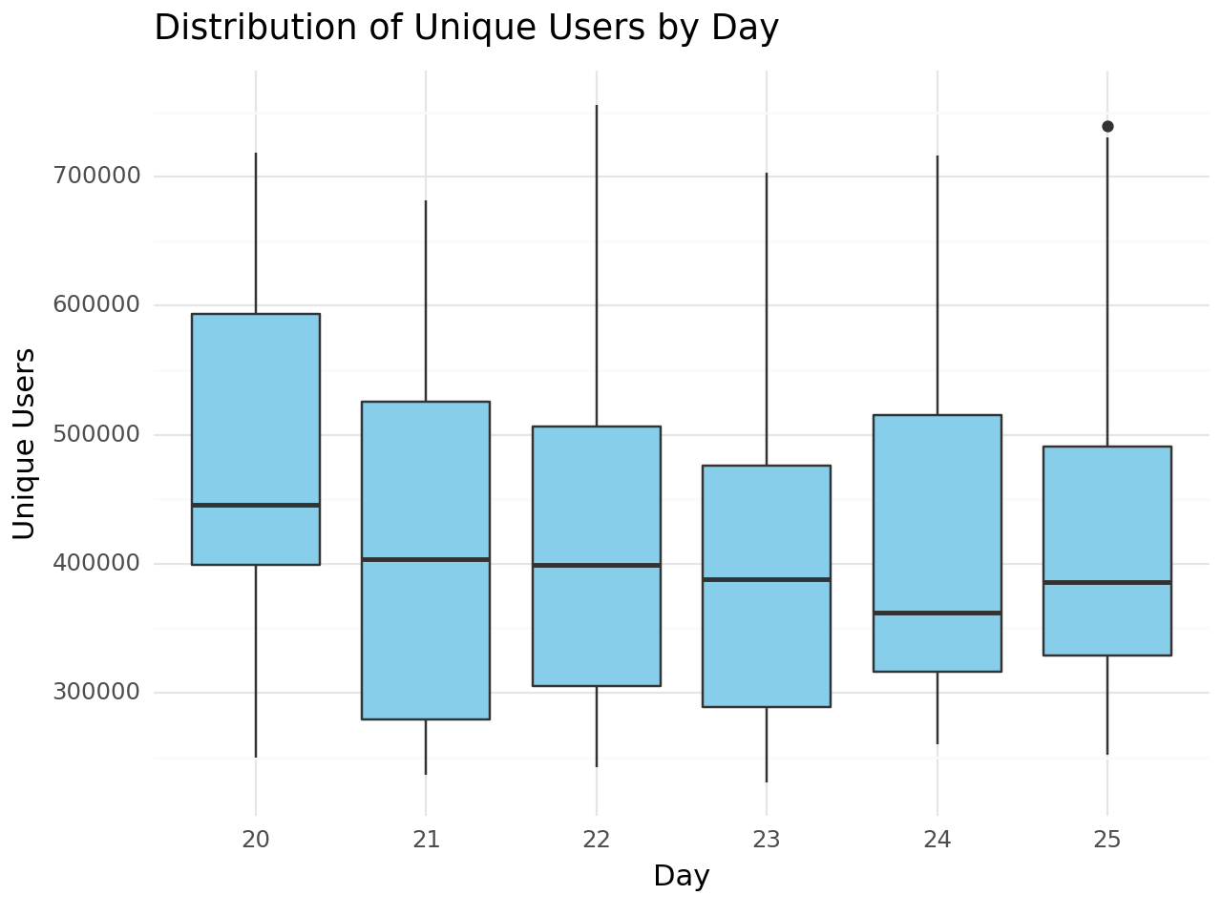
Engagement by User Count

Slide 4
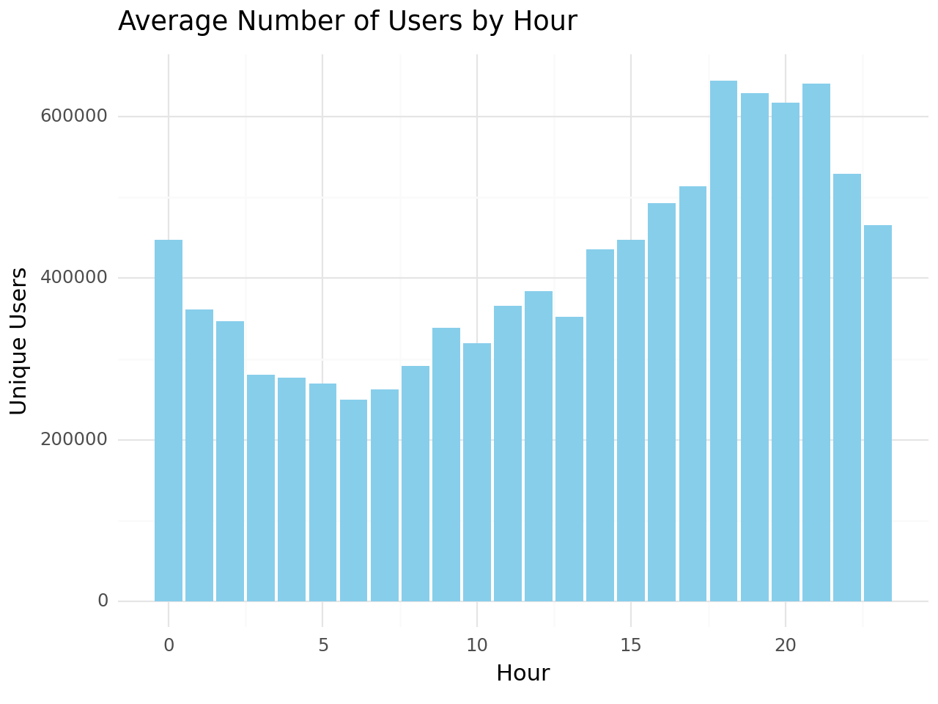
Engagement by User Count

Slide 5
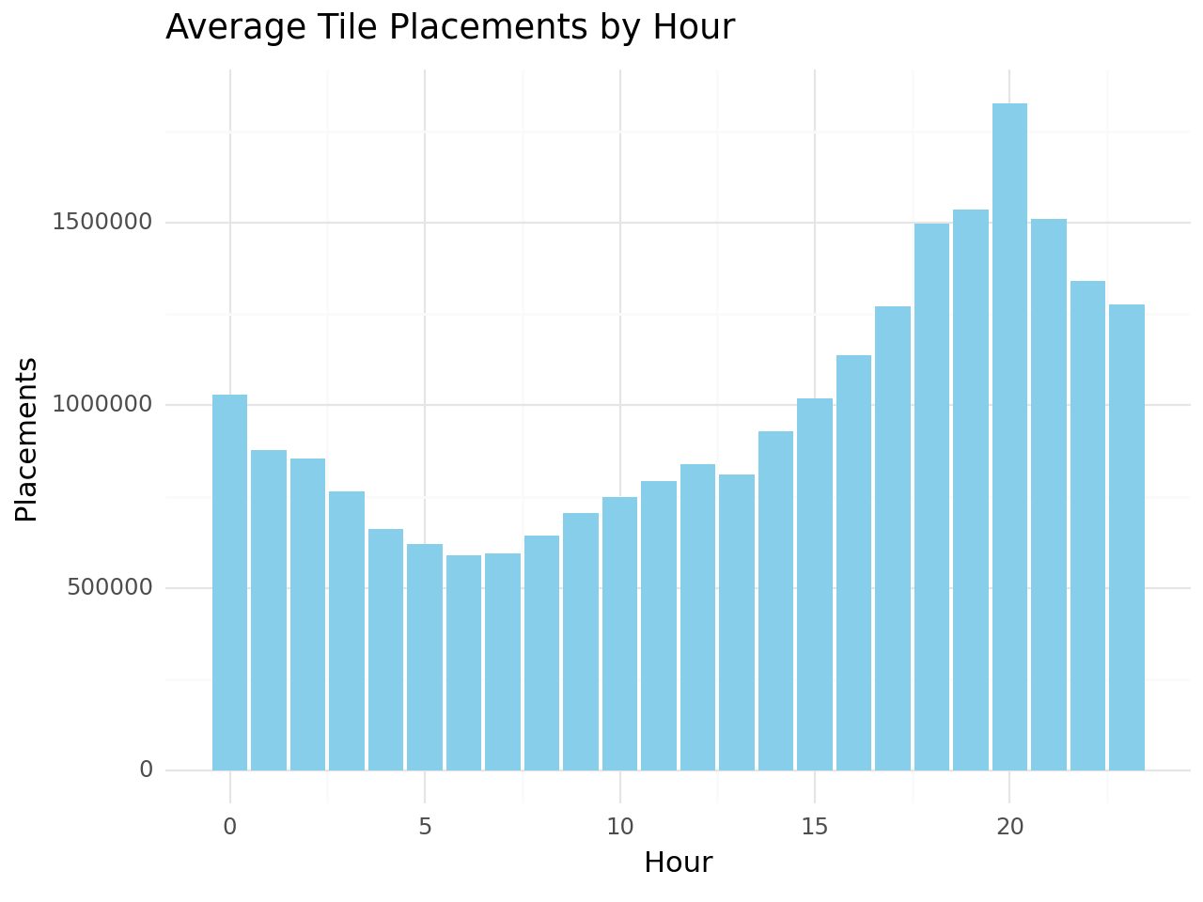
Engagement by Pixel Count

Slide 6
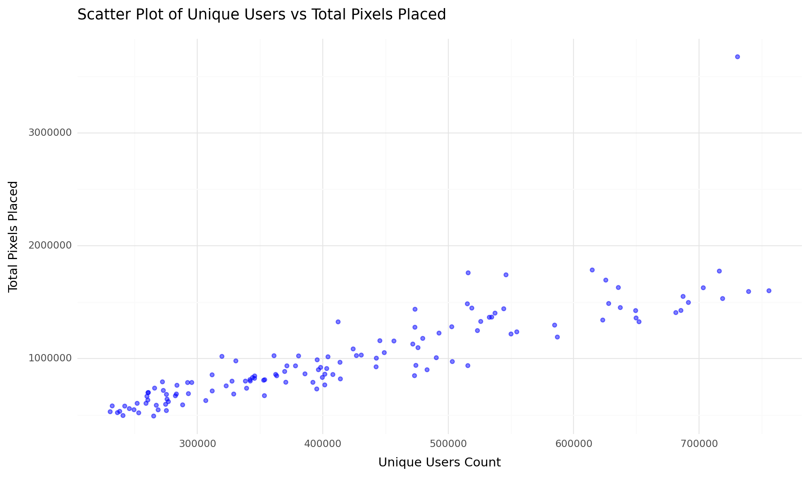
User vs Pixel Engagement

Slide 7
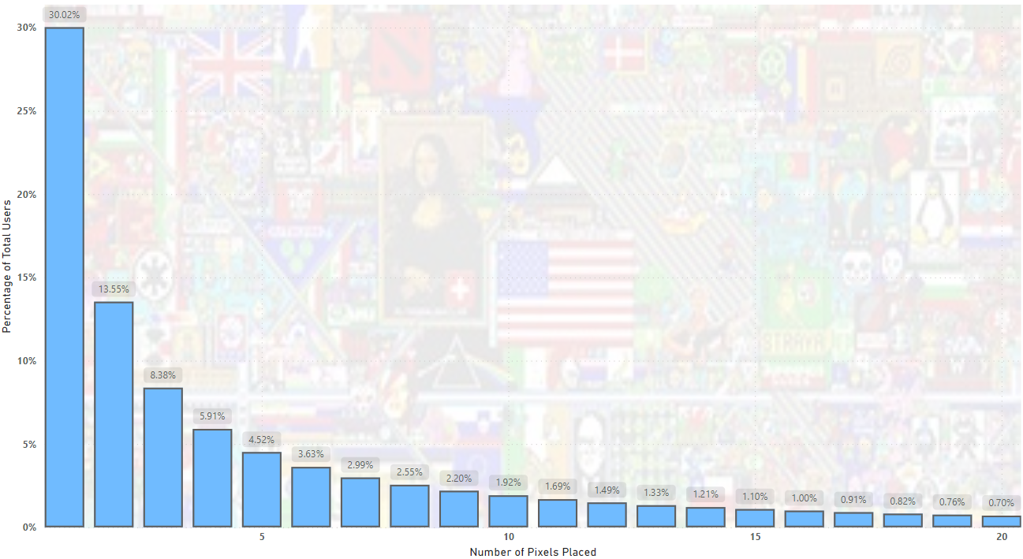








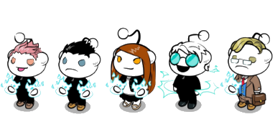
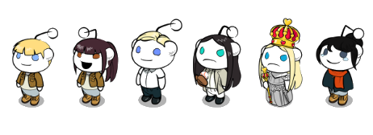
User Pixel Frequency
Notes:
This bar chart looks at user pixel placement frequency and as you can see 30 percent of users only placed 1 pixel and then declines steeply after that

Slide 8
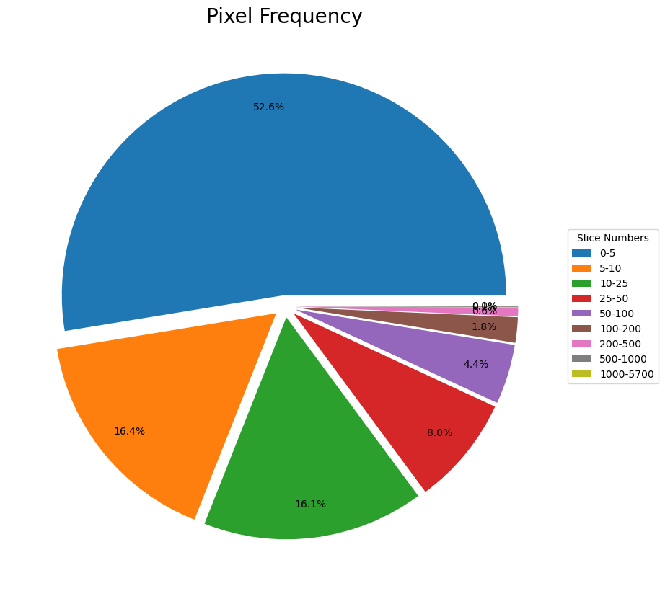
Notes:
This is a pie chart of pixel placement frequency and we found that more than 50 percent of users put 5 or less pixels

Slide 9
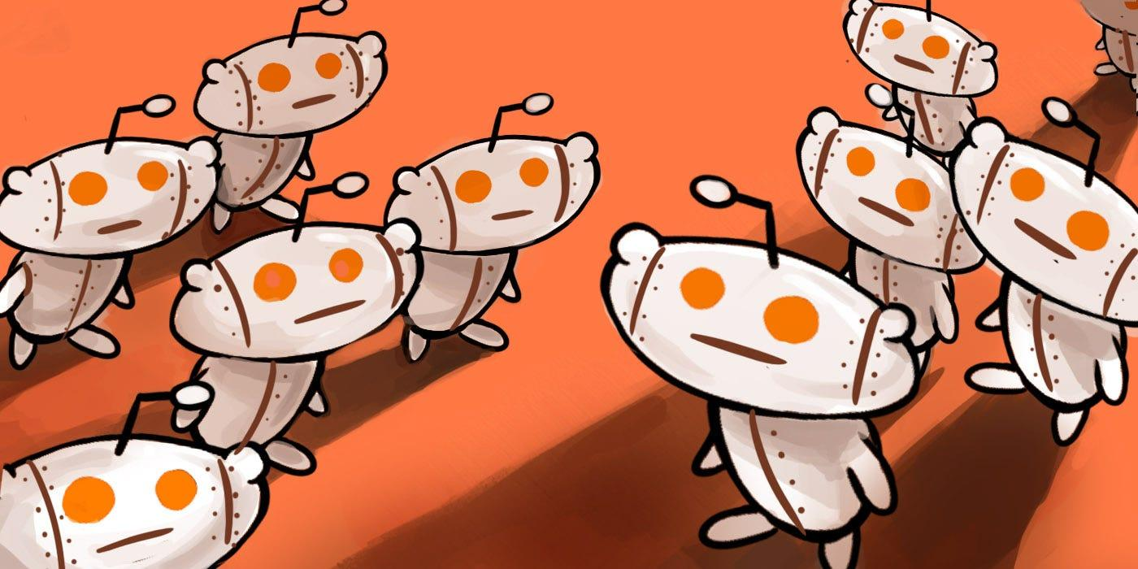

Slide 10

Exploration used to distinguish between authentic users & bots:
Sampled 5,000,000 rows
1:00pm - 6:20pm
07/20/2023
High post users: 42,000 rows
STD and Mean: 29,000 rows
X & Y variability

Slide 11
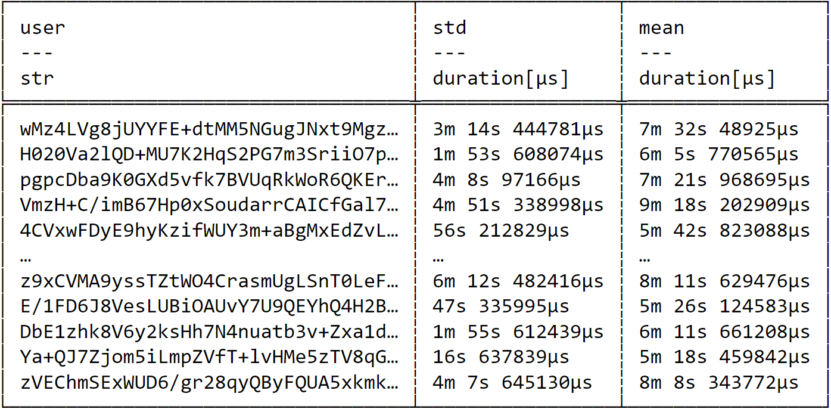

Slide 12
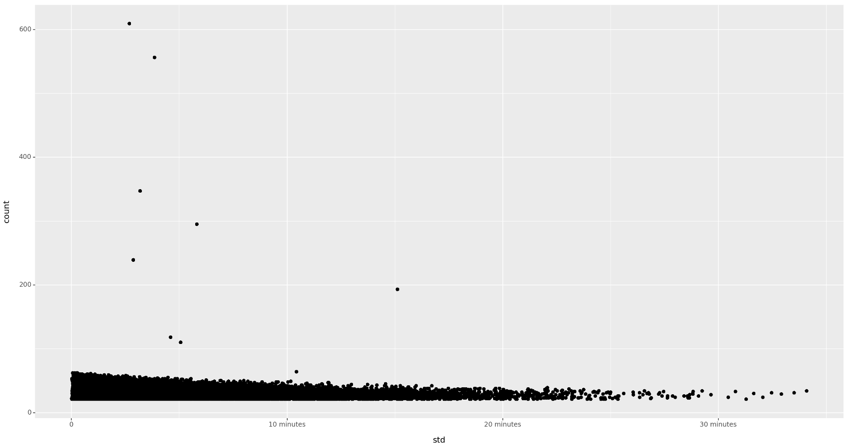

Slide 13
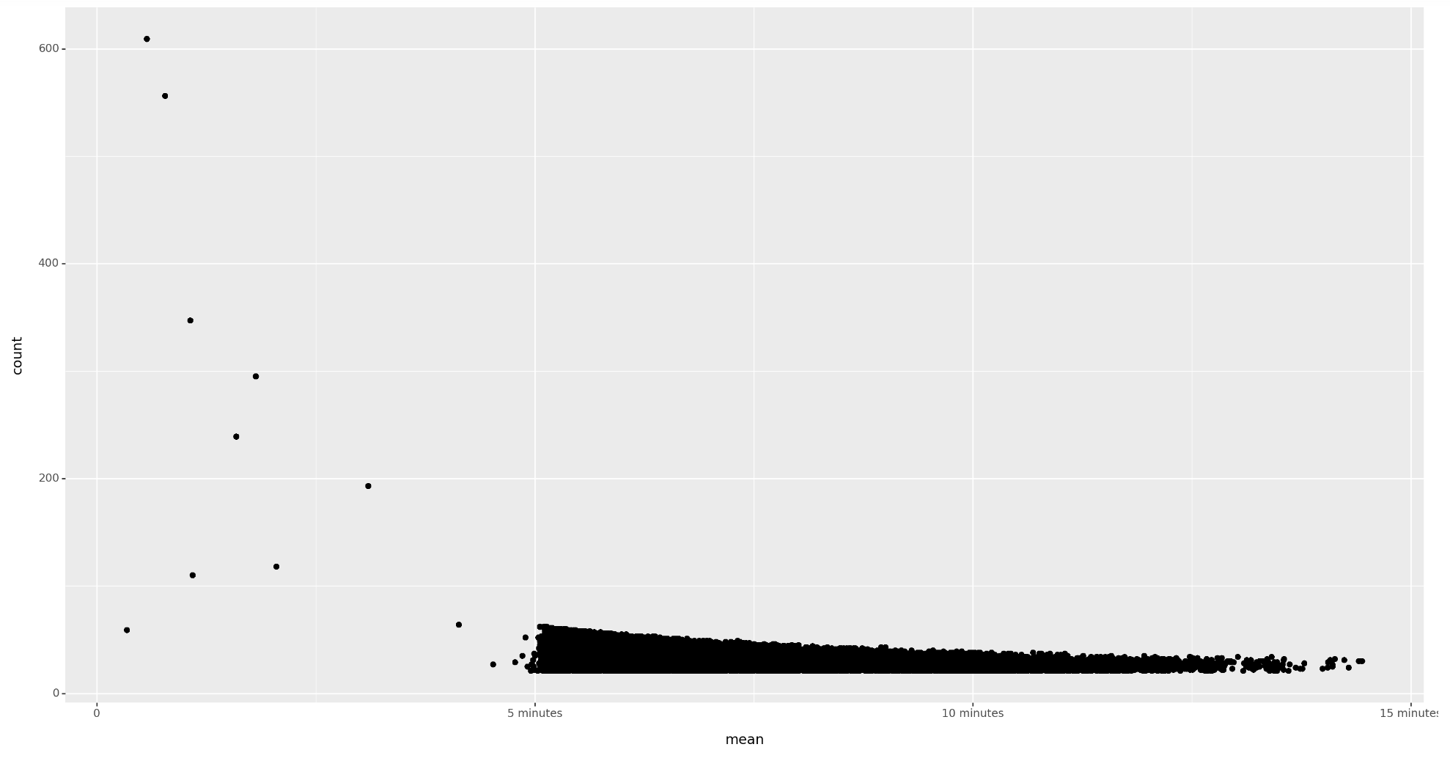

Slide 14


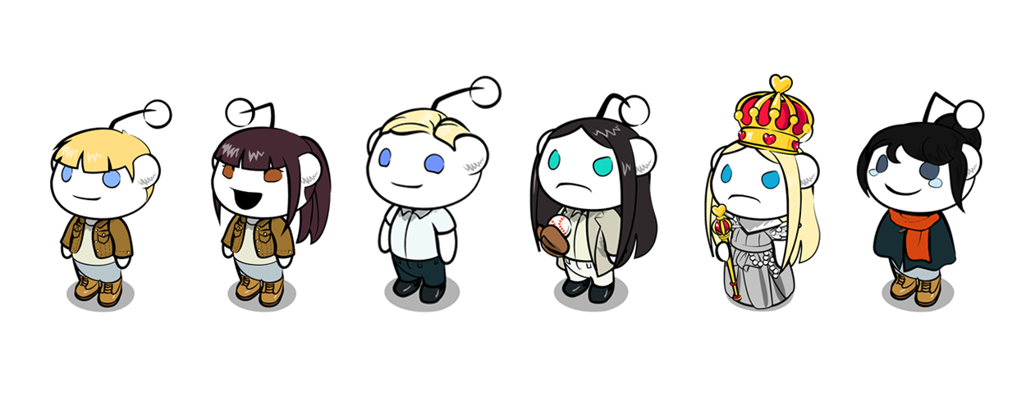
Bot Detection
Cut-Off Value | Number of Suspected Bots | Suspected Bot % | Number of Bot Pixels Placed
.9 (35 Pixels Placed) | 848,000 | 10% | 72,400,000 (60% of total pixels)
.95 (60 Pixels Placed) | 426,000 | 5% | 53,400,000 (44% of total pixels)
.99 (158 Pixels Placed | 84,500 | 1% | 22,300,000 (18.4% of total pixels)
Took the 90th percentile of pixel placements as most likely bots.
We decided to pick the 90th percentile as a cutoff for bot activity because the negative effects of a false positive are minimal
In the future we would like to expand our detection techniques to look at if there are accounts that only post on the same spot/same color and examine time variance further
Notes:
8.4 Million unique users
121 Million Pixels

Slide 15

R/Place Canvas Bots Only
We recreated the image with only suspected bots for cutoff values of the 90th, 95th, and 99th quantile of pixel placement
Examined the three images to look for areas that were very filled out across the three images
Found that the bots really dislike Spez (Reddit CEO Steve Huffman), really like to make flags (German flag, Turkish flag, French flag), and make some really cool art (highlighted on next slide)

Slide 16
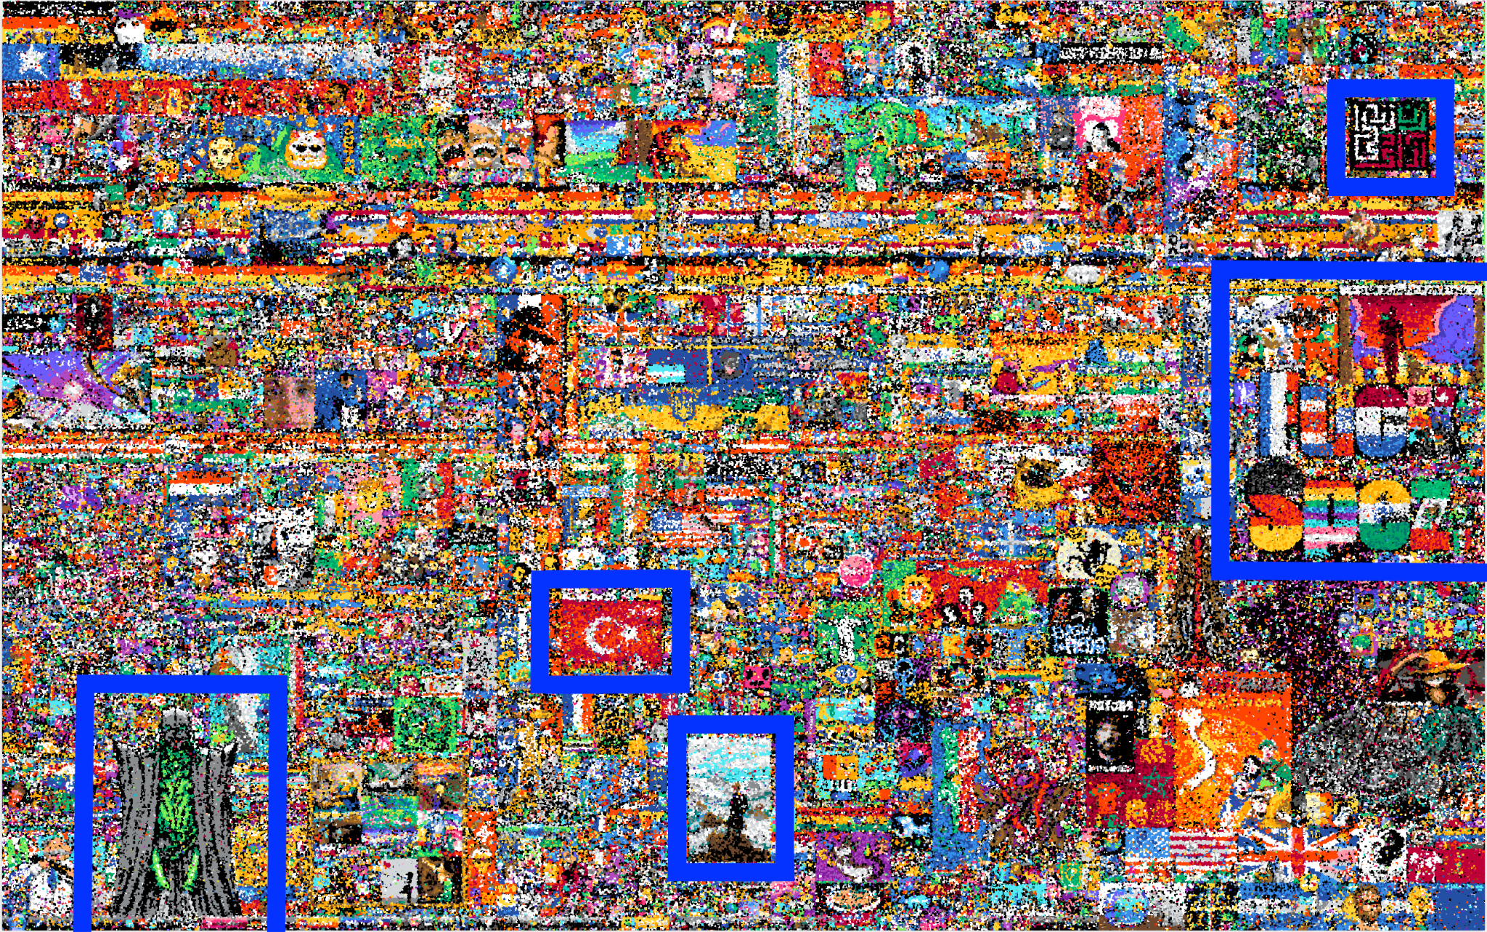

Slide 17

Any Questions?

